Slide 1

CSUF Swap
Huy Ho
Christopher Ta
Marco Chavez

Slide 2
Updates
Dynamic Theme (Dark / Light)
Shortcut routes
UI improvements
Detail Releasing
SWAP Floor, Time and Location
Release APK

Slide 3

Welcome Screen

Slide 4
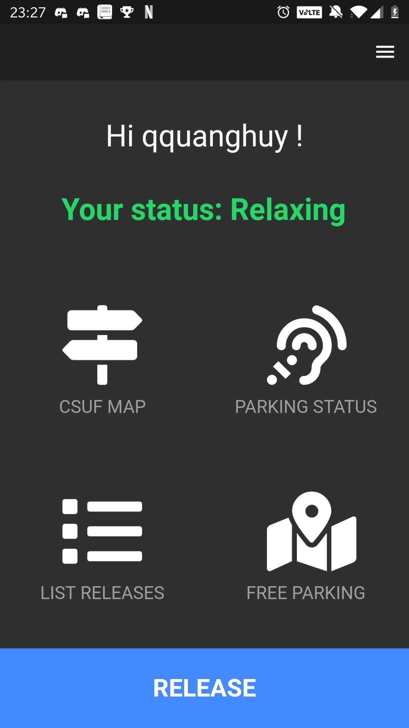
Home Screen

Slide 5
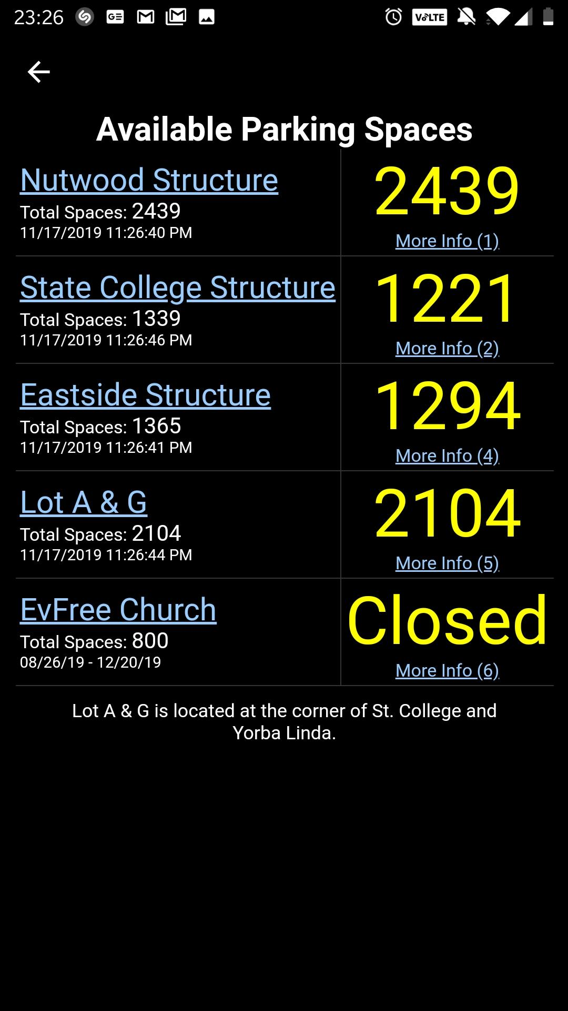
Parking Status

Slide 6
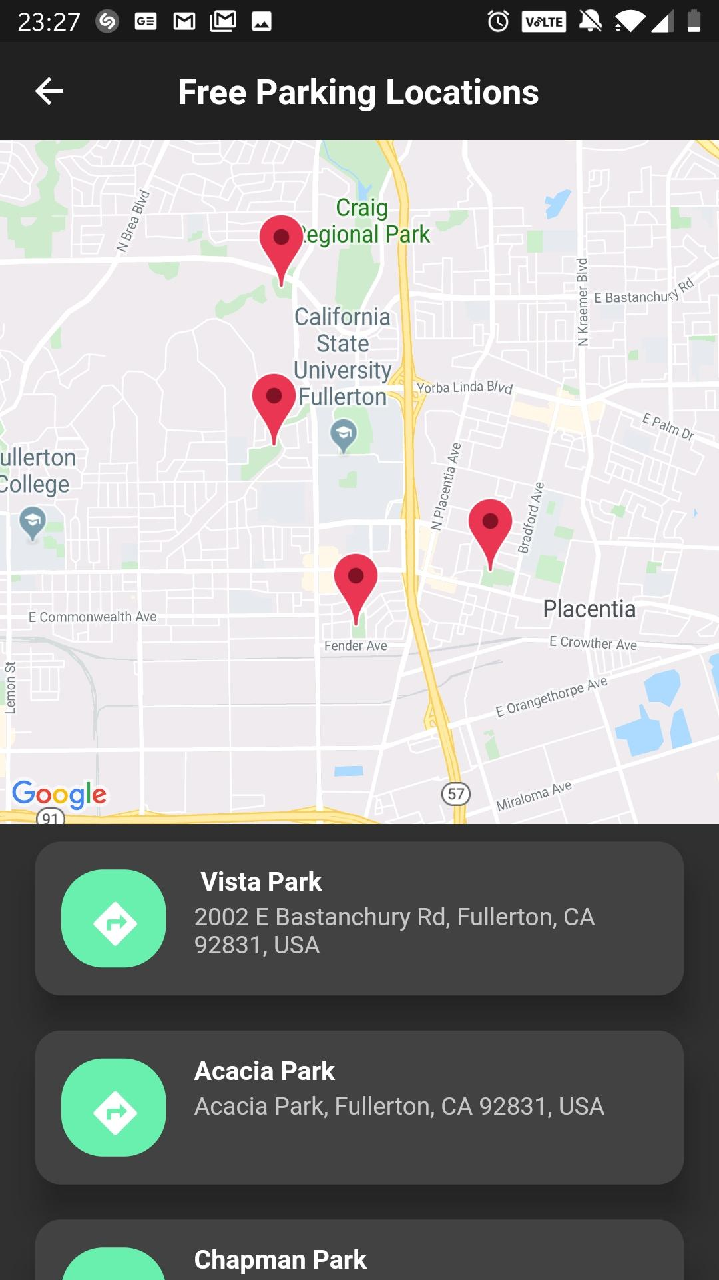
Free Parking Location

Slide 7
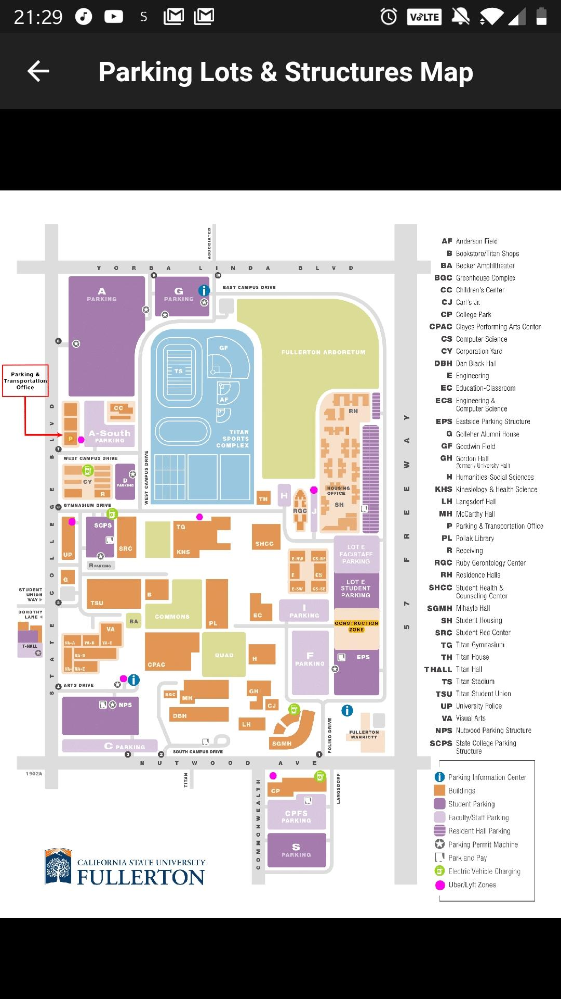
Parking Lot Map

Slide 8
Demo
Release
Request
Get Requested
Swap

Slide 9
Q & A

